Slide 1
American Economy in the 1950’s
Noel Figueroa
ECO 202
Dr. Alisher Akhmedjonov

Slide 2
Ten-Year Period of U.S. Economic History Overview
This post war period was characterized by massive economic growth until the Vietnam war.
During the 1950’s, WWII was over and people were recovering from the war effects.
Overly, the economy grew by 37 % over this decade.
By the end of the decade, the average family had a buying power of over 30 % as compared to the previous decade (war time).
The GI Bill was a big factor that led to the addition of college graduates to the work force during the decade.
Unemployment varied especially during recessions in 1954 and 1958, shrinking to 4.5% in the middle of the decade.
Notes:
The 10 years between 1950 and 1960 saw many ups and downs in the U.S. economy, however the decade had an increased aggregate economic growth of 37 % compared to the previous years.
There were many reasons that led to the growth of the American Economy in this post war period. Specifically, in 1958 recession ended and in 1959 Fed increased interest rates that saw the Real DP increase by $3.187 trillion. The country was opened up to the world for trade after the war. For instance, America’s trade with Europeans countries increased. Jobs increased and hence unemployment lowered. Domestic wells were used to produce cheaper oil for Americans this way, many goods and services were able to be produced cheaply than it had been. In that event, petroleum exportation was organized that helped the economy toward its healing process after the huge recession. Technology advances made engineering and manufacturing skills in high demand, which was being filled by veterans who used their GI Bill to gain those necessary skills.

Slide 3
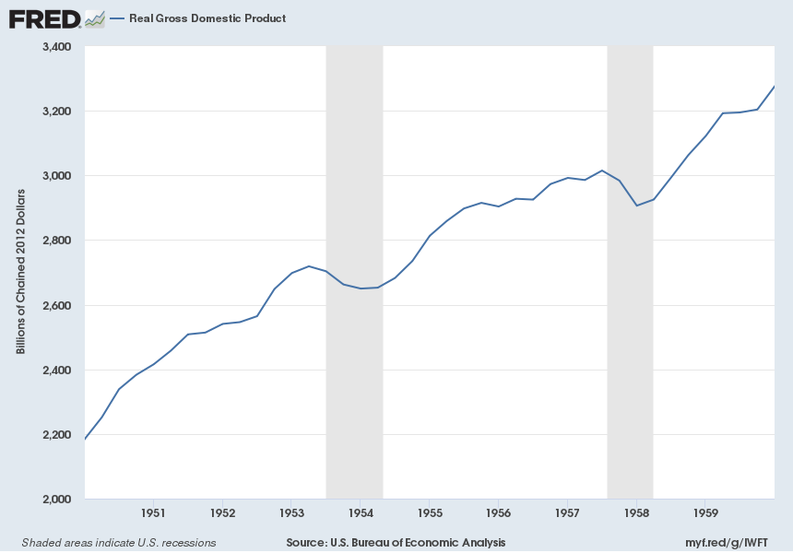
GDP through the decade
Notes:
GDP growth was not that constant through the decade. However, it was characterized by most positive advances as shown in the table. The only exceptions were short spurts of recessions that occurred in 1954 (when Dow returned) and 1958 (as the recession was ending). In ‘54 the recession lasted about 10 months and the GPD took a 2.2% dip and in 1958 the 8 month recession caused a larger 3.3% dip. This recession was due to lack of foreign trade and caused the unemployment rate to drop to 6%. 1955 witnessed the highest GDP growth of 7.1%.
Buying on credit became prominent in many families. This helped to stimulate the economy, during this decade the private debt was more than doubled. The private sector debt went from $104.8 billion to $263.3 billion.
Korean War was also a factor in the large increase in GDP during the years of 1950-53.

Slide 4
GDP STATISTICS IN THE DECADE
Yeah | Nominal GDP (trillions) | Real GDP (trillions) | GDP -Growth Rate
1950 | $0.300 | $2.290 | 8.7%
1951 | $0.347 | $2.472 | 8.0%
1952 | $0.367 | $2.575 | 4.1%
1953 | $0.389 | $2.696 | 4.7%
1954 | $0.391 | $2.680 | -0.6%
1955 | $0.426 | $2.871 | 7.1%
1956 | $0.449 | $2.932 | 2.1%
1957 | $0.474 | $2.994 | 2.1%
1958 | $0.481 | $2.972 | -0.7%
1959 | $0.522 | $3.178 | 6.9%
Notes:
Major notable economic elements that happened in the decade towards the above GDP statistics are noted as:
In 1950, the Korean war was ongoing that led to the hugest GDP growth of 8.1% through 8.0% in 1951 as depicted in the table;
In 1953, the war ended and recession was welcomed.
In 1954, Dow returned to 1929 high. The year witnessed a negative GDP growth.
In 1957, recession intensified.
In 1959, the Recession ended despite the economy witnessing a negative GDP growth.
In 1959, Fed raised taxes.

Slide 5
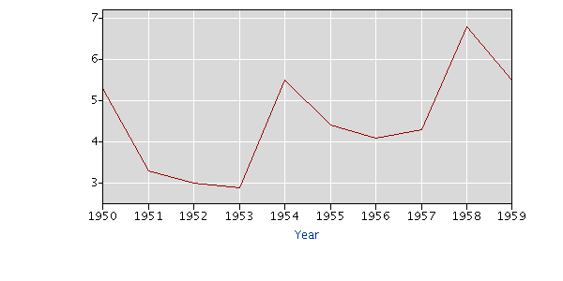
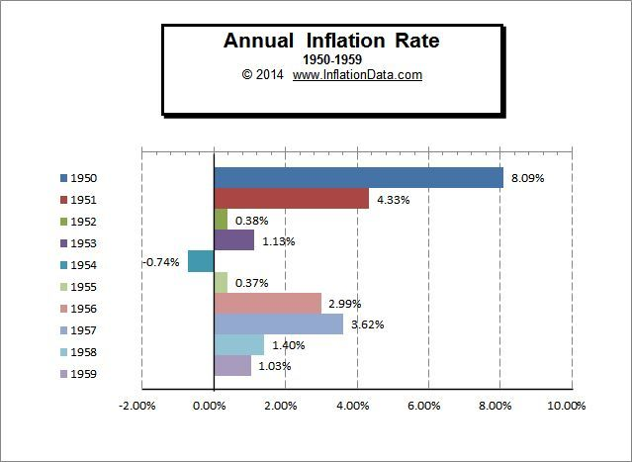
Unemployment and Inflation
Year | Annual
1950 | 5.3
1951 | 3.3
1952 | 3.0
1953 | 2.9
1954 | 5.5
1955 | 4.4
1956 | 4.1
1957 | 4.3
1958 | 6.8
1959 | 5.5
Notes:
The table and the graph represents the unemployment rate.
With WWII over, there was a large influx of European countries trading with America, boosting the economy and thus creating more opportunities for employment. Also with the Korean War, there were factories building weapons which also helped to create more jobs here, that war continued to lower the unemployment rate up to 1953 where unemployment rate was at 2.9%, the lowest in that decade (U.S. Bureau of Labor Statistics, 2018).
In this time, inflation was caused by output beyond capacity, moderate unemployment, and lack of permanent inflation-unemployment trade off.
In 1953, Korean War was over and with factories closing and European countries also feeling out of economic track, unemployment rose to 5.5% in 1954. As the economy began to stabilize with the introduction of buying on credit, the end of decade saw overall increase of 37% and left Americans with over 30% more buying power than at the beginning of the decade.
In 1960s, the economy witnessed low normal unemployment rate.
In the early 1970s, low natural rate of unemployment and inflation was sensitive to slack. In mid 1970s, natural rate of unemployment grew to moderate and the inflation grew somewhat to slack.

Slide 6
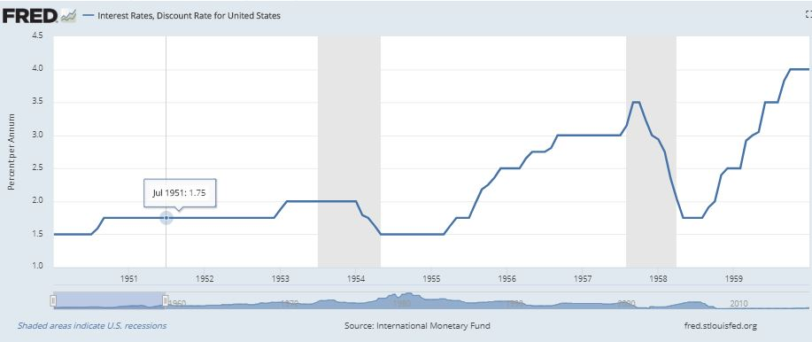
Interest Rates
Notes:
As interest rate increase, trying to get a loan becomes a bit more difficult. People become hesitant to borrow as loans become more expensive so there is less amount of items purchased but consumers would save more. As interest rates lower, people tend to spend more especially when purchasing items on credit, this will increase consumer debt. Interest rates and GDP should almost mirror each other. For example, if looking at both lines on a graph, they should almost be the same. This would be the most ideal version of economic growth.
Recessions are often in the event of economic growth, and whenever they come, the FED uses fiscal policies as a strategy to end the increased inflation stimulating consumption. Increasing interest rates is one fiscal policy that Fed took in 1959 to stimulate consumption by lowering levels of inflation.

Slide 7
Interest Rates in 1950s
Year | Interest Rate
1950: Jan-July Aug Sep-Dec | 1.50 1.59 1.75
1951: Jan - Dec | 1.75
1952: Jan - Dec | 1.75
1953: Jan Feb -Dec | 1.88 2.00
1954: Jan Feb Mar April May-Dec | 2.00 1.79 1.75 I.63 1.50
1955: Jan- Mar April May-July Aug Sep Oct Nov Dec | 1.50 1.63 1.75 1.97 2.18 2.25 2.36 2.50
1956: Jan – Mar April May – July Aug Sep – Dec | 2.50 2.65 2.75 2.81 3.00
1957: Jan – July Aug Sep-Oct Nov Dec | 3.00 3.15 3.50 3.23 3.00
1958: Jan Feb Mar April May – Aug Sep Oct Nov Dec | 2.94 2.75 2.35 2.03 1.75 1.91 2.00 2.40 2.50
1959: Jan – Feb Mar April May Jun – Aug Sep Oct - Dec | 2.50 2.92 3.00 3.05 3.50 3.83 4.00
Notes:
The economy seemed dilapidated in the times of recession.
Two major factors that happened after the WW II had great impact on the economy.
i) economic impact of returning GIs – the entire baby boom population
ii) huge interest rates that the FED took to restore inflation and unemployment.
Hiking interest rate in 1959 saw the economy return to a period of recession in the year 1960 with a GDP decline from 6.9% to 2.6%.
This recession was maintained until 1961 when John F. Kennedy’s spending was partaken to end the recession in the economy.

Slide 8
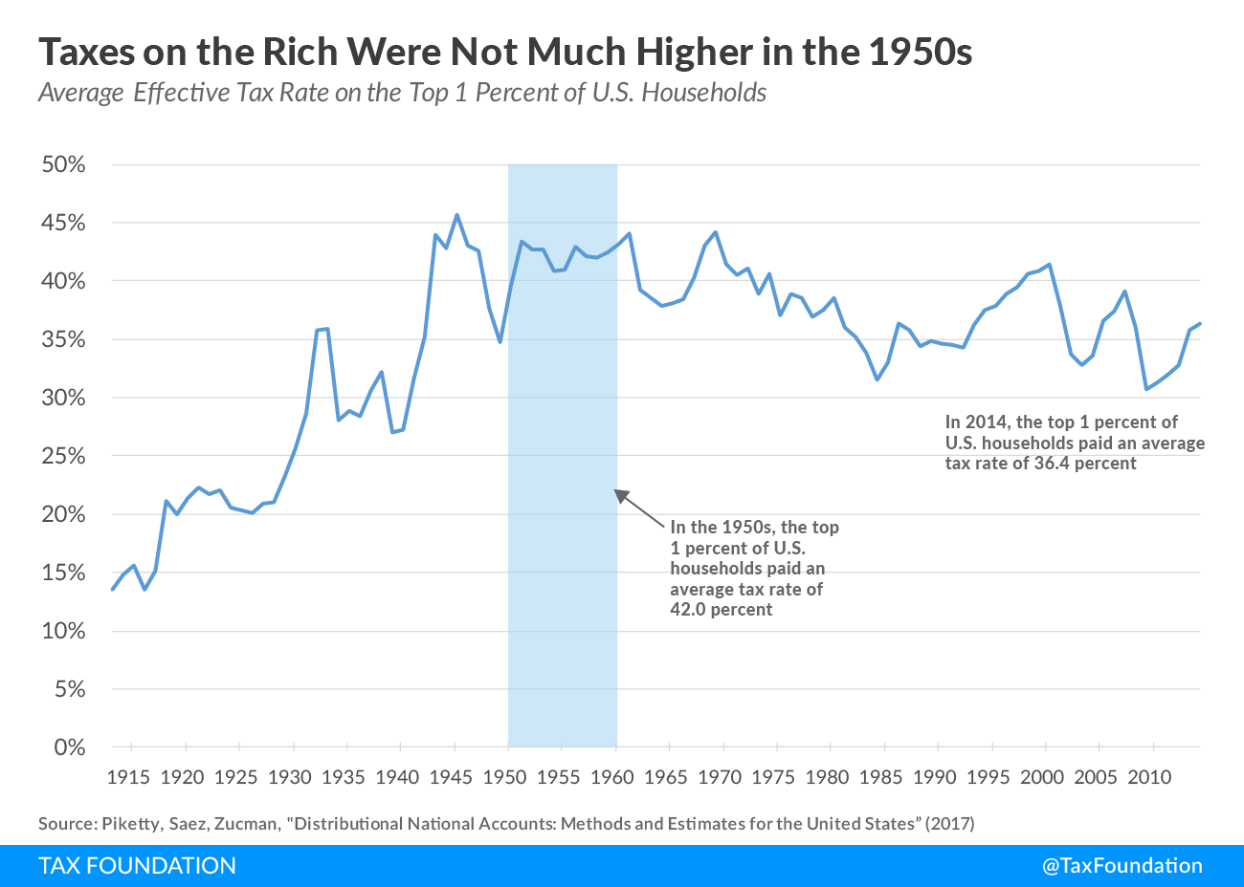
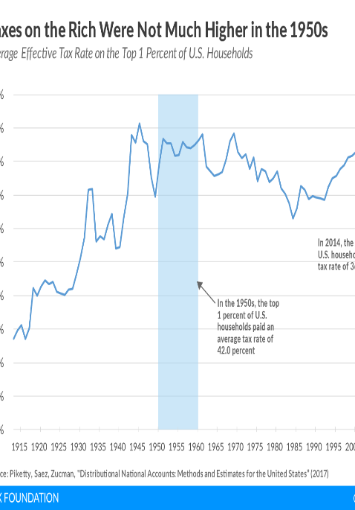
Fiscal Policies of the 1950’s
The decade began in a recession, until the beginning of the Korean War
The Korean war helped to bring the economy around due to increase need for military spending.
GDP began as high as 8.7% in 1950 then we as low as -0.6% in 1954 when the DOW was at a high
Top income tax rate reached a high of 91% yet the top 1% of Americans, the rich, only paid around 42% of their income taxes.
Under President Eisenhower the Internal Revenue Code of 1954 was passed due to bipartisan collaboration.
Fed increased interest rates
Notes:
After the Second World War, deliberate and systematic effort to utilize fiscal policy to stimulate the economy to operate closely to its potential while avoiding detriments like inflation became a standard practice in the economy. For instance, the Korean War was of help to the economy in the beginning of the decade, however, after the war there was a recession that was caused due to a huge surge of unemployment. With the military coming back from the war, there was no longer a demand for wartime goods and services. Federal spending increased due to the Korean War, the Cold War, and domestic polices such as expansion of some aspects of the New Deal and the construction of the Interstate Highway system. However, this was offset by high income tax rates, with a top rate of 90% to begin the decade.
To deal with the recession of this period, the Congress passed a stimulus package 1958 to help support businesses and bring the economy out of its slump. Another fiscal policy that was taken is the increase of interest rates during the time to around 4% as shown in a previous table.

Slide 9
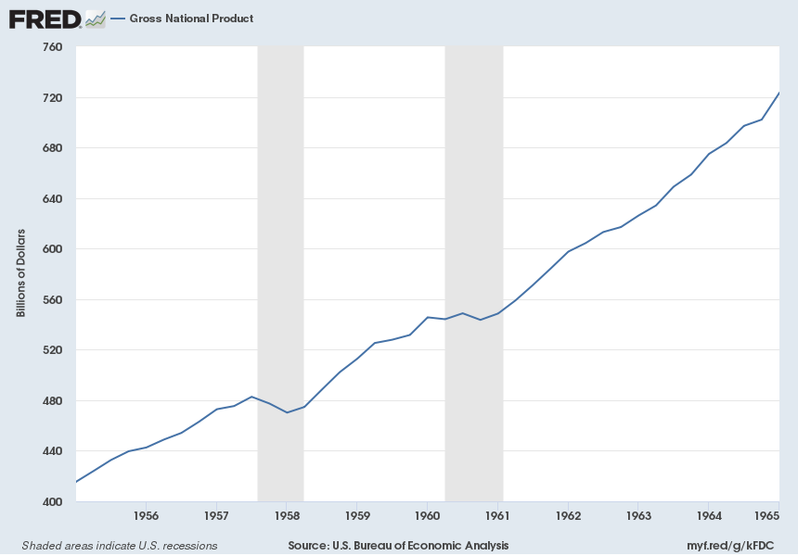
Fiscal Policy Impact: Taxes and Expenditures
The recession of 1957 and 1958 saw an increase in unemployment by 7%
Taxes in the 1950s stayed relatively stable.
Taxes were used to raise revenue while at the same time stabilizing economic activity.
Due to the wars, defense spending was the highest expenditure during this decade
Interstate highway project of 1956 was also a major contributor to expenses in this decade.
Notes:
During the recession of 1957-58, we see major dips, however during the following years, although there were some dips, none were as deep as they were during the recession. The following years saw a steading increase in the employment rates.
Eisenhower fought against tax cuts that could have increase Federal debt that was already in the hole due to the increased military spending due to the wares of this decade. The only exception to any tax policy was the increase in the fuel tax to help pay for the Highway expansion of 1956

Slide 10
Fiscal cont.
Federal tax policy – it was implemented after the employment act hence its impacts were felt in this decade.
This policy was restrictive though progressive in nature.
Federal expenditure policy:
  This policy was not consistent with the Employment Act
  During periods of recession and recovery it was stimulative only two-thirds of the time. During periods of excess demand it was always simulative; two of these periods, however were associated with wars.
Notes:
The government worked hard to refrain the economy from dragging itself into the post-war depression.
Previously, an Employment Act had been implemented that targeted maximum but not full employment, trigger production and stir up purchasing power.
This tax, apparently reflected the progressive nature of the tax system and the continuing increases in social security taxes, even with the multitude of tax actions legislated throughout the periods.

Slide 11
Monetary Policy of the 1950s
Monetary policy during this time followed policies from the early 1900s
Low and stable inflation began late in the decade and years to come
CPI started at 23.5% early this decade
Unemployment average was 4.7% in the beginning of the decade
Notes:
Interest rates on bonds were kept low while the U.S. entered WWII to allow cheaper financing of the war. President Truman wanted these low interest rates to continue through the Korean War as a way to protect the people that were purchasing bonds. CPI continued to grow since 1948 and raised into the low 20% early through the 1950s which caused concern for inflation. Between 1952 and 1960, average annual inflation was less than 2 percent, the U.S. economy expanded at an average annual rate of 2.9.

Slide 12
Monetary Policy Actions of the 1950s
With the outbreak of the Korean War in 1950, Fed and the Treasury strategized to maintain a “pegged” market.
Following the 1951 Accord, the Federal Reserve was focused on controlling inflation
In 1952, large scale discounting was revived and fostered for use by authorities. Bank borrowing rose to 1.6 billion by the end of 1952
In 1953, monetary authorities were willing to coordinate actions with the treasury. In the event, “bills-only” policy was reached at.
Notes:
The ability for banks to independently set interest rates, helped to slow the rate of inflation. This change coincided more or less with the acceleration in the pace of business activity and the intensification of the demand for bank credit toward mid-1952. As a result of the increasing pressure on bank reserves, bank borrowing at Federal Reserve banks rose from about $300 million in March 1952 to a record level of $1.6 billion by the end of the year.

Slide 13
CHANGES IN MONETARY SUPPLY, GROSS NATIONAL PRODUCT AND PRICES OVER THE DECADE
Money supply (seasonally adjusted) Current dollars (billions) Constant (1954) dollars (billions) | June 1950 115.9 120.7 | June 1960 138.0 120.8 | Percentage increase 19.1 0.8
GNP (2nd quarter data, annual rates, seasonally adjusted) Current dollars (billions) Constant (1954) dollars (billions) | 326.4 340.0 | 505.0 442.2 | 54.7 30.1
Prices GNP implicit deflator (2nd quarter data, 1954 = 100) Consumer price index | 96.0 110.8 | 114.2 126.5 | 19.0
Notes:
The overwhelming concern of our monetary authorities in recent years with the problems of inflation is so familiar that documentation of the record is hardly necessary.
The quantitative impact of the Federal Reserve Board's restraint on the growth of the money supply relative to certain other economic magnitudes may be seen in the Table.
The fact appears to be that the Board has subordinated full employment as a goal of policy.
This seems evident from its willingness to "tighten the vice" in the presence of appreciable excess capacity both at the end of prosperity in 1956-7 and in the recovery of 1958-9.
Between January and July, 1957, as money was becoming tighter, seasonally adjusted unemployment was less than 4 per cent in only one month, whereas in all of 1956 in only one month was it as high as 4 per cent.4 At the end of 1958, as money was tightening, seasonally adjusted unemployment was 6.1 per cent and by March, 1959, was still 5.8 percent.

Slide 14
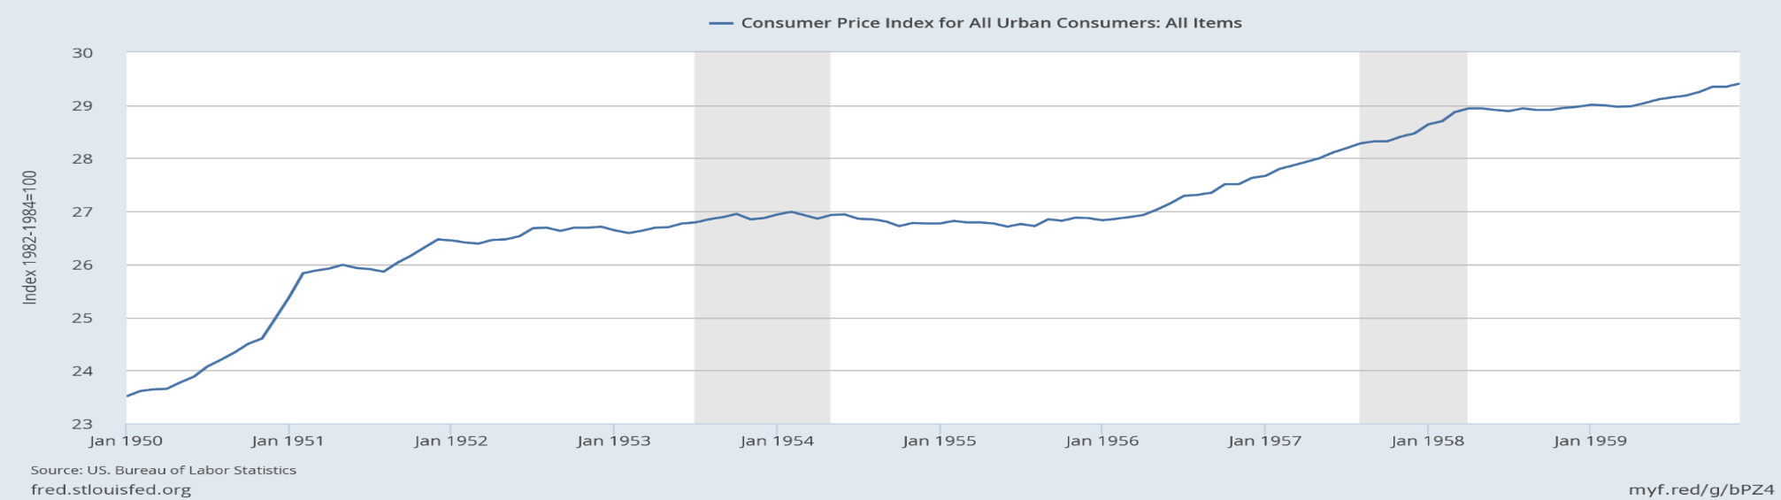
Monetary Policy Impact of the 50s
CPI index rose sharply during the first years of the decade
Independent interest rate leveled CPI index
Inflation remained low during this period but increased shortly after
Notes:
Following the 1951 Accord, the policies set in place, controlled inflation and the CPI throughout the decade. Federal Reserve was granted the opportunity to independently control interest rates which helped to slow inflation and “level” the CPI. During this decade, there was the ending of the war and beginning of a new one, recessions, and yet there was good economic growth.
Commercial banks have been both stabilizing and destabilizing factors in the government securities market. On the one hand, they have emerged as permanent, large holders-and by far the largest institutional holders-of government securities. However, they are also a group whose relative instability in holdings is exceeded only by that of non-financial corporations.
Important to the plight of the Treasury in managing its debt is a group of developments related to the competitive pressures of other areas for the financial savings of society

Slide 15
Conclusion
The U.S. Economy underwent a shift in this decade that created more income for the Americans than ever before.
Despite the economy being affected by inflation in the early 1950s, it did not take that long before the economy started recovering.
Some important economic plights include:
  General rising of prices
  Currency losing its value
  Recession, which was at hand of these problems
By mid 1950s, the economy had began celebrating the fruits of prosperity and economic boom.
Notes:
This robust economy that developed into prospects of excessive production led to the rise of the American Middle class people.
The people who had grown up during the depression era of poverty and misery of the World War II were now happily marrying, developing their families and exploring opportunities in a variety of work opportunities.
Additionally, the GI Bill implemented to fund veterans pursuing tertiary and post secondary education, was very supportive to those people who faced challenges in a bid to earn their degrees as a strategy to earn themselves better paying jobs.
Also, small business were witnessed to grow, corporations merging to increase their competitive advantages as well as market cap gradually becoming more powerful and competitive.
Labor was in dire need; specifically skilled and non-skilled labor since companies needed to manage their asset base, work their assembly lines and sale their commodities to the pubic.
People positioned themselves as opportunities were many.

Slide 16
Conti…
This decade was referred to as the “Decade of prosperity”. This because:
Consumption greatly increased - With a nudge from TV advertising and its ceaseless pitches to purchase everything from beer to bathroom tissue, Americans increasingly became consumers.
A lot of job opportunities – from the development of industries and companies, the labor market was characterized by more demand than the supply at the time.
Notes:
It does not mean that the previous years Americans were not purchasing items, of course, Americans also had purchased things in previous decades. But during the 1950s, more people had enough money to buy nonessential items, and those who didn't were making their major purchases on credit.
At the same time, the commercial banking industry expanded, with insurance, trust, and holding companies also entering the money business.
With the ready availability of jobs and credit, the 1950s offered most people the ability to purchase all sorts of goods and services for their material comfort.

Slide 17
References
shmoop.com (Nov. 2018) Economics in the 1950s retrieved from https://www.shmoop.com/1950s/economy.html
Encyclopedia.com (Nov 2018) The 1950s Business And The Economy: Overview Retrieved from: https://www.encyclopedia.com/social-sciences/culture-magazines/1950s-business-and-economy-overview
FRED Economic Data (2018). Real Gross Domestic Product, 3 Decimal (GDPC96). Retrieved from: https://fred.stlouisfed.org/series/GDPC96/
FRED Economic Data (2018) Bank Prime Loan Rate (MPRIME). Retrieved from: https://fred.stlouisfed.org/series/MPRIME
Inflationdata.com (Nov 2018) Annual Inflation Rate by Decade Retrieved from: https://inflationdata.com/articles/inflation-cpi-consumer-price-index-1950-1959/
Data.gov (Nov 2018) Bureau of Labor Statistics Retrieved from: https://data.bls.gov/pdq/SurveyOutputServlet
"The 1950s Business and the Economy: Overview." U*X*L American Decades. . Retrieved December 17, 2018 from Encyclopedia.com: https://www.encyclopedia.com/social-sciences/culture-magazines/1950s-business-and-economy-overview
Thebalance.com (Nov 2018) US GDP by Year Compared to Recessions and Events Retrieved from: https://www.thebalance.com/us-gdp-by-year-3305543
Taxfoundation.org (Nov 2018) Taxes on the Rich Were Not That Much Higher in the 1950s Retrieved from: https://taxfoundation.org/taxes-rich-1950-not-high/
Nber.com (Nov 2018) A Rehabilitation of Monetary Policy in the 1950s Retrieved from: https://www.nber.org/digest/jun02/w8800.html
Federalreservehistory.org (Nov 18) From the Treasury-Fed Accord to the Mid-1960s Retrieved from: https://www.federalreservehistory.org/essays/treas_fed_accord_to_mid1960s

